Slide 1

PowerBI
Diphoko KK
Notes:
Please read through my notes, this is where I explain pictures

Slide 2
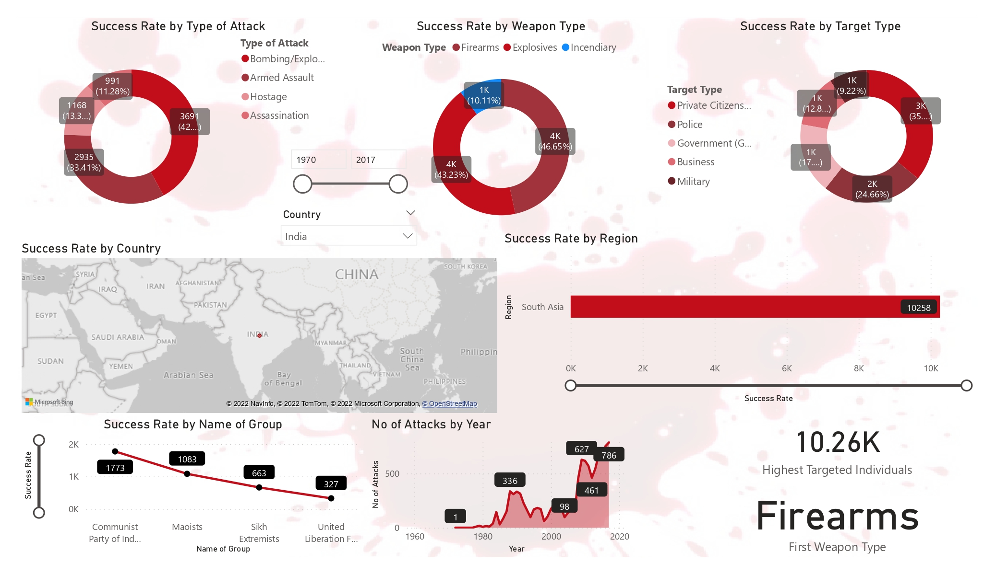
Notes:
Success Rate by Type of Attack:
The pie chart shows the success rates for different types of attacks. These include:
Bombing/Explosion: Approximately 11.28% success rate.
Armed Assault: Around 13.3% success rate.
Assassination: Success rate of 9.22%.
Hostage Taking (Barricade Incident): Success rate of 12.8%.
Hostage Taking (Kidnapping): Approximately 24.66% success rate.
Facility/Infrastructure Attack: Success rate of 43.23%.
Unarmed Assault: Success rate of 10.11%.
Success Rate by Weapon Type:
Another pie chart displays success rates based on weapon types:
Explosives/Bombs/Dynamite: 83.41% success rate.
Firearms: 4.0% success rate.
Incendiary devices: 2.0% success rate.
Melee weapons (non-explosive/non-firearm): 0.0% success rate.
Chemical or Fake Weapons: 0.0% success rate.
Success Rate by Target Type:
The third pie chart categorizes success rates by target type:
Private Citizens & Property: 10.11% success rate.
Police forces/agencies/officers/detectives/spies/informants/etc.: 13.3% success rate.
Government (General): 9.22% success rate.
Business entities/companies/corporations/firms/etc.: 24.66% success rate.
Religious Figures/Institutions/Organizations/Symbols/etc.: 43.23% success rate.
Military forces/agencies/officers/soldiers/troops etc.: 12.8% success rate.
Other: 10.11% success rate.
Success Rate by Country:
The map highlights China and India, indicating their respective success rates.
No of Attacks by Year:
The bar graph shows the trend in the number of attacks over several years.
Success Rate by Name of Group:
Unfortunately, the specific group names are not fully visible in the image.
Highest Targeted Individuals:
The number “10.26K” represents the highest targeted individuals.
Firearms First Weapon Type:
Firearms are the most commonly used weapon type.

Slide 3
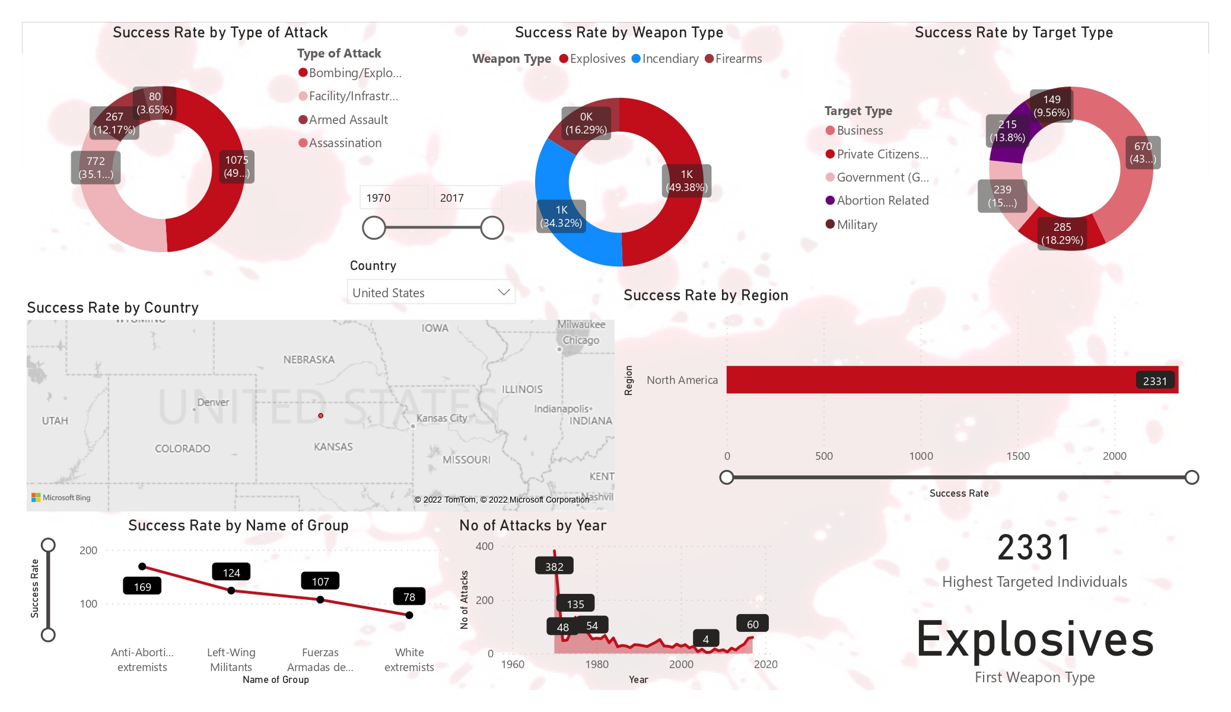
Notes:
Success Rate by Type of Attack:
The pie chart shows the success rates for different types of attacks. These include:
Bombing/Explosion: Approximately 11.28% success rate.
Armed Assault: Around 13.3% success rate.
Assassination: Success rate of 9.22%.
Hostage Taking (Barricade Incident): Success rate of 12.8%.
Hostage Taking (Kidnapping): Approximately 24.66% success rate.
Facility/Infrastructure Attack: Success rate of 43.23%.
Unarmed Assault: Success rate of 10.11%.
Success Rate by Weapon Type:
Another pie chart displays success rates based on weapon types:
Explosives/Bombs/Dynamite: 83.41% success rate.
Firearms: 4.0% success rate.
Incendiary devices: 2.0% success rate.
Melee weapons (non-explosive/non-firearm): 0.0% success rate.
Chemical or Fake Weapons: 0.0% success rate.
Success Rate by Target Type:
The third pie chart categorizes success rates by target type:
Private Citizens & Property: 10.11% success rate.
Police forces/agencies/officers/detectives/spies/informants/etc.: 13.3% success rate.
Government (General): 9.22% success rate.
Business entities/companies/corporations/firms/etc.: 24.66% success rate.
Religious Figures/Institutions/Organizations/Symbols/etc.: 43.23% success rate.
Military forces/agencies/officers/soldiers/troops etc.: 12.8% success rate.
Other: 10.11% success rate.
Success Rate by Country:
The map highlights China and India, indicating their respective success rates.
No of Attacks by Year:
The bar graph shows the trend in the number of attacks over several years.
Success Rate by Name of Group:
Unfortunately, the specific group names are not fully visible in the image.
Highest Targeted Individuals:
The number “10.26K” represents the highest targeted individuals.
Firearms First Weapon Type:
Firearms are the most commonly used weapon type.

Slide 4
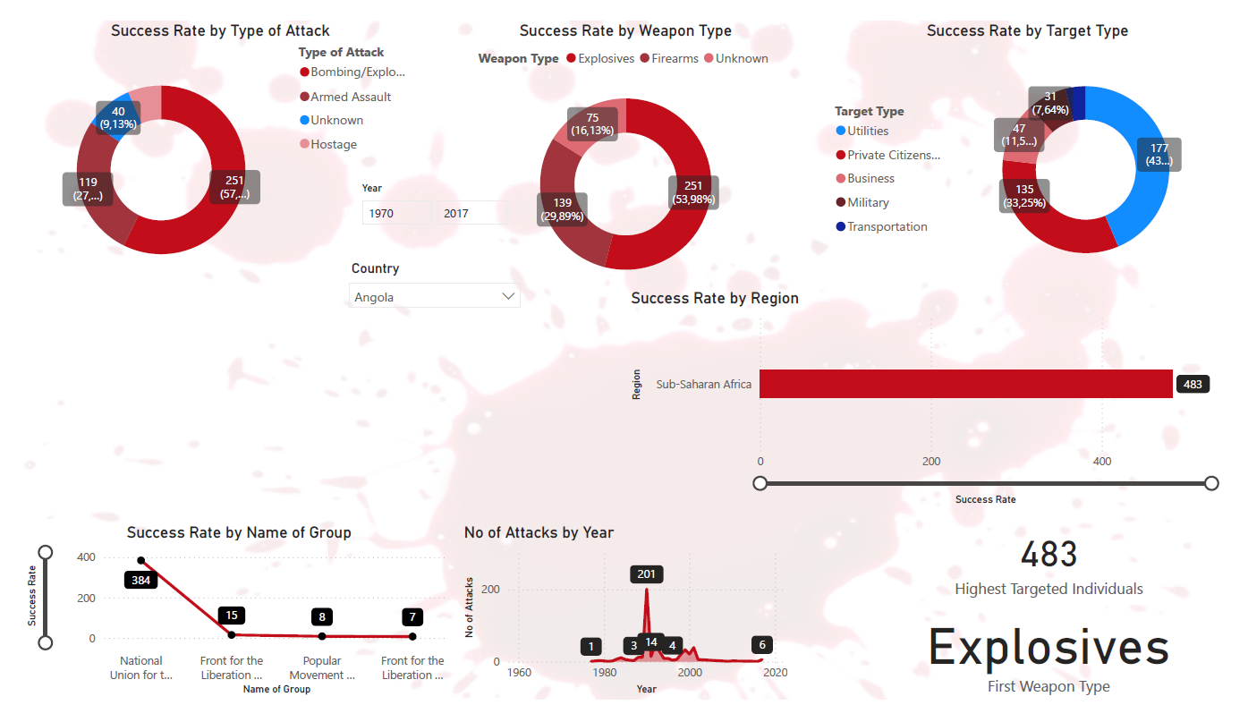
Notes:
Success Rate by Type of Attack:
The leftmost pie chart shows the success rates for different types of attacks:
Bombing/Explosion: Approximately 11.28% success rate.
Armed Assault: Around 13.3% success rate.
Assassination: Success rate of 9.22%.
Hostage Taking (Barricade Incident): Success rate of 12.8%.
Hostage Taking (Kidnapping): Approximately 24.66% success rate.
Facility/Infrastructure Attack: Success rate of 43.23%.
Unarmed Assault: Success rate of 10.11%.
Success Rate by Weapon Type:
The middle pie chart displays success rates based on weapon types:
Explosives/Bombs/Dynamite: 83.41% success rate.
Firearms: 4.0% success rate.
Incendiary devices: 2.0% success rate.
Melee weapons (non-explosive/non-firearm): 0.0% success rate.
Chemical or Fake Weapons: 0.0% success rate.
Success Rate by Target Type:
The rightmost pie chart categorizes success rates by target type:
Private Citizens & Property: 10.11% success rate.
Police forces/agencies/officers/detectives/spies/informants/etc.: 13.3% success rate.
Government (General): 9.22% success rate.
Business entities/companies/corporations/firms/etc.: 24.66% success rate.
Religious Figures/Institutions/Organizations/Symbols/etc.: 43.23% success rate.
Military forces/agencies/officers/soldiers/troops etc.: 12.8% success rate.
Other: 10.11% success rate.
Success Rate by Country:
The map highlights China and India, indicating their respective success rates.
No of Attacks by Year:
The bar graph shows the trend in the number of attacks over several years.
Success Rate by Name of Group:
Unfortunately, the specific group names are not fully visible in the image.
Highest Targeted Individuals:
The number “10.26K” represents the highest targeted individuals.
Firearms First Weapon Type:
Firearms are the most commonly used weapon type

Slide 5
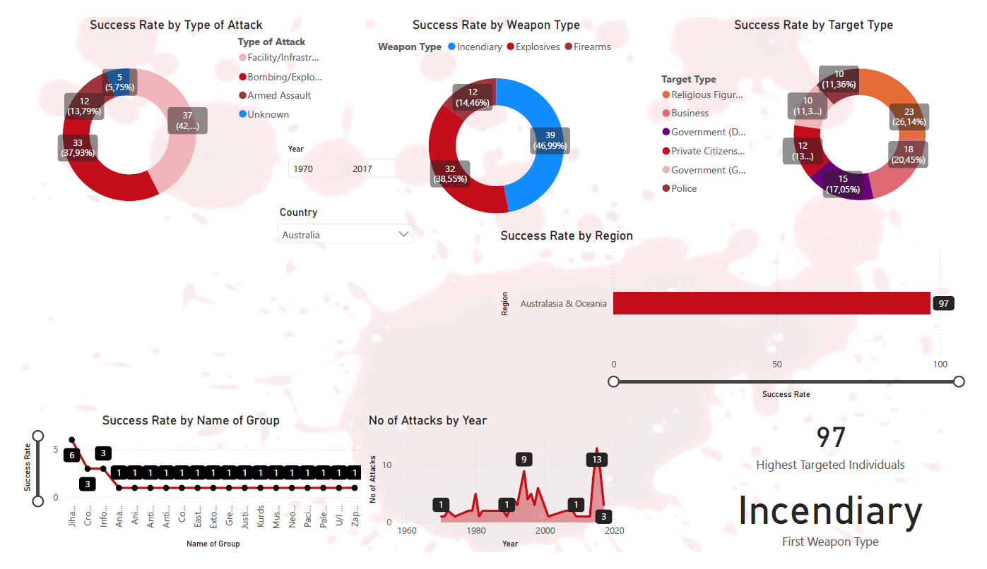
Notes:
Success Rate by Type of Attack:
The leftmost pie chart shows the success rates for different types of attacks:
Bombing/Explosion: Approximately 11.28% success rate.
Armed Assault: Around 13.3% success rate.
Assassination: Success rate of 9.22%.
Hostage Taking (Barricade Incident): Success rate of 12.8%.
Hostage Taking (Kidnapping): Approximately 24.66% success rate.
Facility/Infrastructure Attack: Success rate of 43.23%.
Unarmed Assault: Success rate of 10.11%.
Success Rate by Weapon Type:
The middle pie chart displays success rates based on weapon types:
Explosives/Bombs/Dynamite: 83.41% success rate.
Firearms: 4.0% success rate.
Incendiary devices: 2.0% success rate.
Melee weapons (non-explosive/non-firearm): 0.0% success rate.
Chemical or Fake Weapons: 0.0% success rate.
Success Rate by Target Type:
The rightmost pie chart categorizes success rates by target type:
Private Citizens & Property: 10.11% success rate.
Police forces/agencies/officers/detectives/spies/informants/etc.: 13.3% success rate.
Government (General): 9.22% success rate.
Business entities/companies/corporations/firms/etc.: 24.66% success rate.
Religious Figures/Institutions/Organizations/Symbols/etc.: 43.23% success rate.
Military forces/agencies/officers/soldiers/troops etc.: 12.8% success rate.
Other: 10.11% success rate.
Success Rate by Country:
The map highlights China and India, indicating their respective success rates.
No of Attacks by Year:
The bar graph shows the trend in the number of attacks over several years.
Success Rate by Name of Group:
Unfortunately, the specific group names are not fully visible in the image.
Highest Targeted Individuals:
The number “10.26K” represents the highest targeted individuals.
Firearms First Weapon Type:
Firearms are the most commonly used weapon type.

Slide 6
Summary
Terrorist attacks have emerged as a significant threat to global security. Utilizing a Terrorism dataset, a quantitative analysis of past terrorist incidents and their temporal and spatial patterns was conducted. The Analytic Hierarchy Process (AHP) was employed to categorize the extent of damage caused by terrorist attacks. Various factors influencing these attacks were identified and represented across three dimensions.
The majority of terrorist attacks were carried out using explosives, followed by firearms. The frequency of attacks peaked in 2014 and 2015, with the last six years showing the highest incidence compared to previous decades since 1970. However, the number of attacks began to decline starting in 2014.
On a daily basis, attack frequency was relatively uniform, though lower on the 31st and higher on the 1st and 15th of each month.Iraq experienced the highest number of attacks, followed by Pakistan, Afghanistan, and India.
The Middle East and North Africa region recorded the most attacks, with South Asia ranking second. Private citizens and property were the primary targets of these attacks, followed by military targets. Bombings and explosions were the most common methods used in the attacks.

